Slide 1



Hotel Booking Cancelation Prediction
Hotel Booking Cancelation Prediction
HOTEL BOOKING CANCELATION PREDICTION
IST 718 Big Data Analytics

Slide 2
INTRODUCTION
As per the New York times “ The cancellation rate for bookings in the online booking industry is quite high. Once the reservation has been cancelled, there is almost nothing to be done. “
This creates discomfort for many institutions and creates a desire to take precautions.
Therefore, predicting reservations that can be cancelled and preventing these cancellations will create a surplus value for the institutions
RESEARCH PROBLEM STATEMENT
The main goal is to help the hotels predict if the given booking is going to be cancelled or not.
It can also help in producing better net demand forecasts, improve overbooking/cancellation policies, and have more assertive pricing and inventory allocation strategies.
Results allow hotels to act on bookings with high cancellation probability by understanding the trends and contain the associated revenue losses.
This will also allow the hotels to identify their loyal customers who never cancel their booking and can provide loyalty benefits.

Slide 3
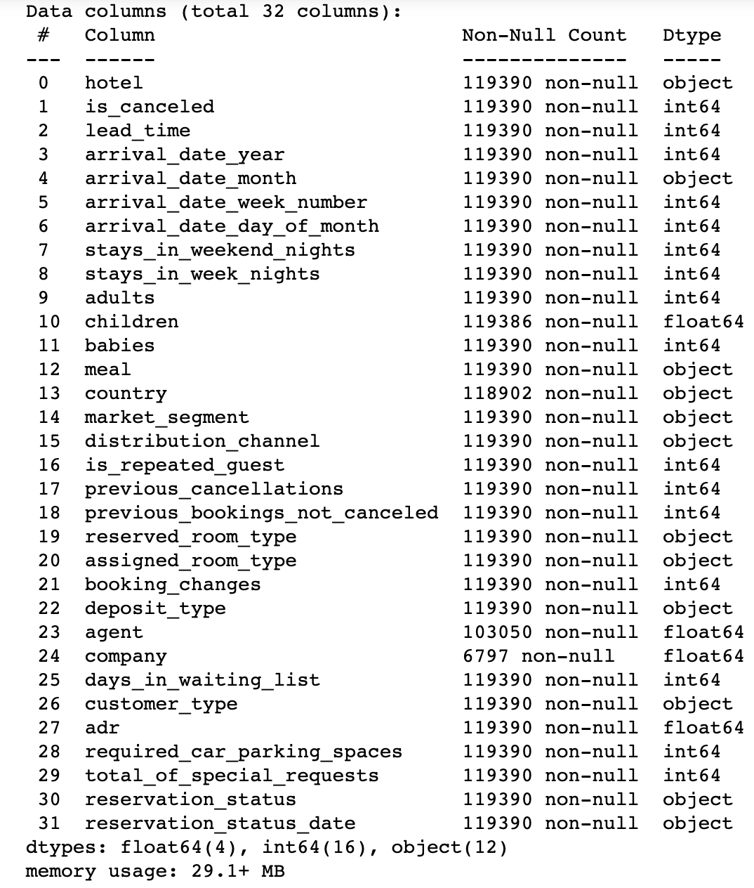
DATA SOURCE
This data set contains booking information for :
City hotel
Resort hotel
The data contains "bookings of guest arrival between the 1st of July 2015 and the 31st of August 2017".
Size: 100,000(approx.) rows x 32 columns

Slide 4

STRATEGY
Data Cleaning and Data Preparation
Exploratory Data Analysis
Feature Selection
Predictive Modeling
ML models
DL ( Forecast the trends using LSTM)
Result Interpretation

Slide 5
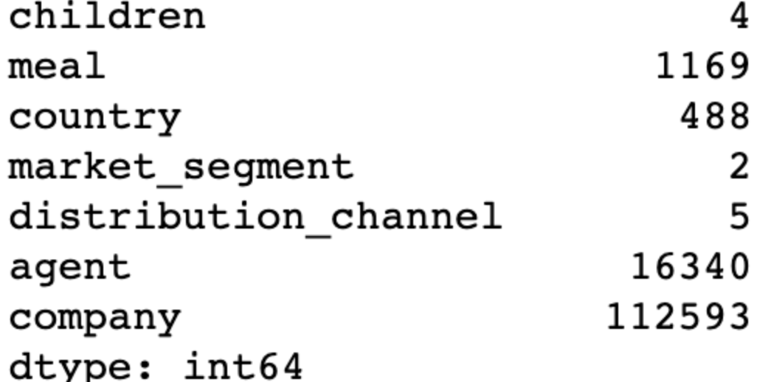
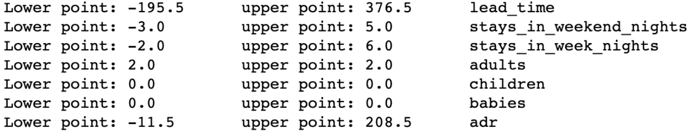
Data Cleaning and Data Preparation
MISSING VALUES
The children and country columns had a missing values.
The missing ‘children’ values were filled with ‘0’ since the average count of children in the entire dataset was very close to ‘0’
The missing ‘country’ values were filled with a variable called ‘unknown’
Some rows contain entries with 0 adults, 0 children and 0 babies, these records were dropped with no guests
OUTLIER DETECTION
We determined the lower and upper points of each column
If there is point between the lower point and the upper point or equal, we do not apply any filtering else, we have removed observations larger and lower than the upper point and lower point of the observations from the data set.
MANAGING DATA TYPES
Changed data-types to category to reduce the memory used by the data-frame
COMBINING COLUMNS
Converted Day, Month, Year into a single arrival date

Slide 6
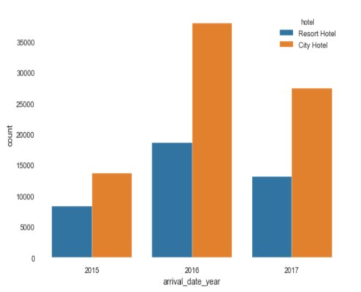
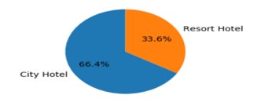
Exploring the Dataset- Data visualization

Slide 7
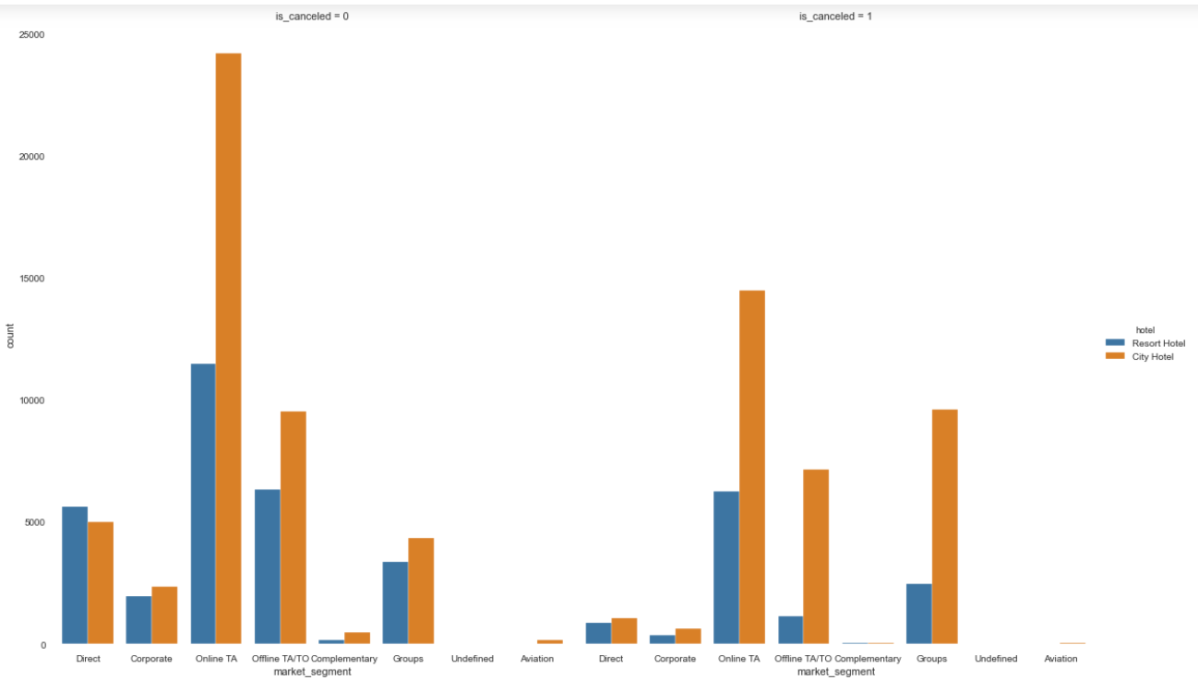
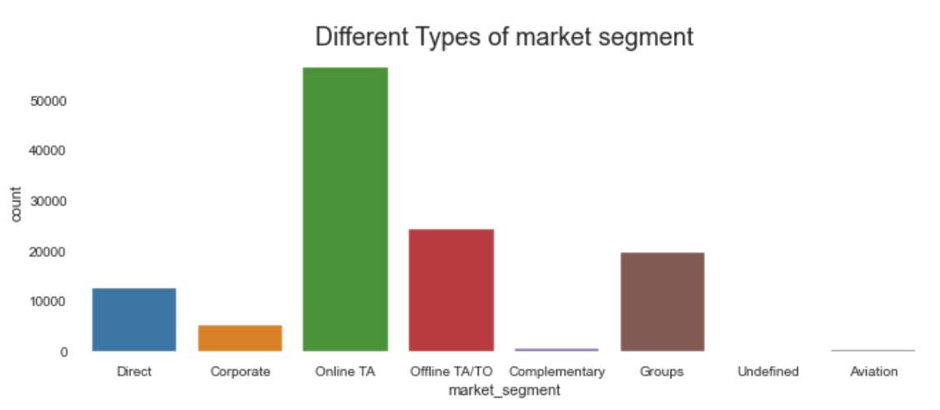
Exploring the Dataset- Data visualization

Slide 8
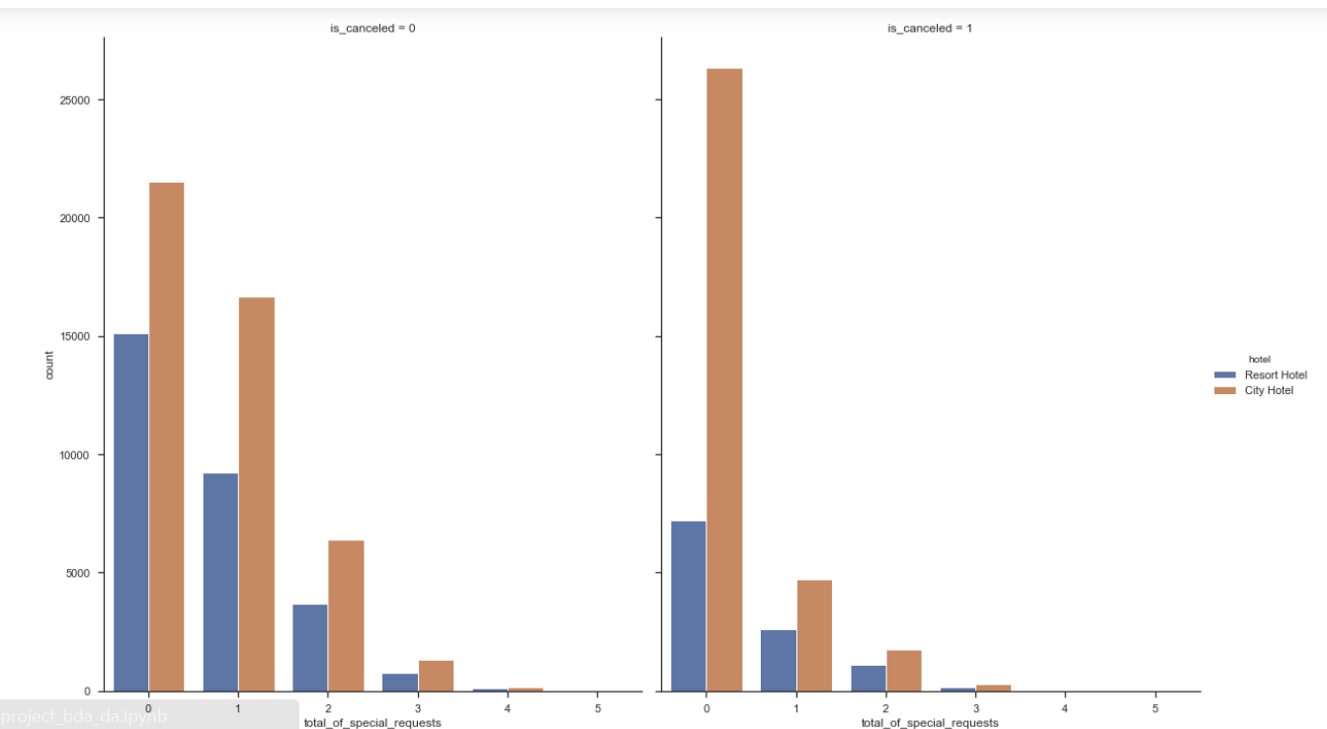
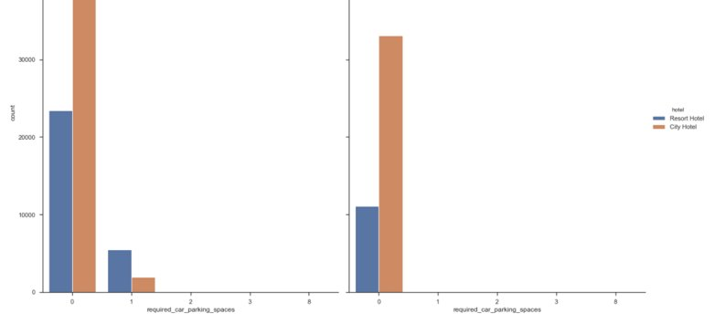
SPECIAL REQUEST ANALYSIS

Slide 9
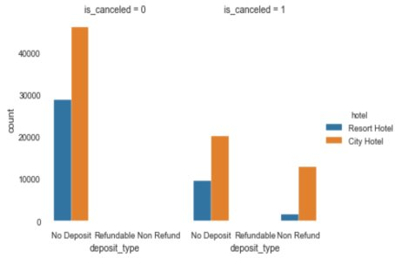
Payment Type Analysis

Slide 10
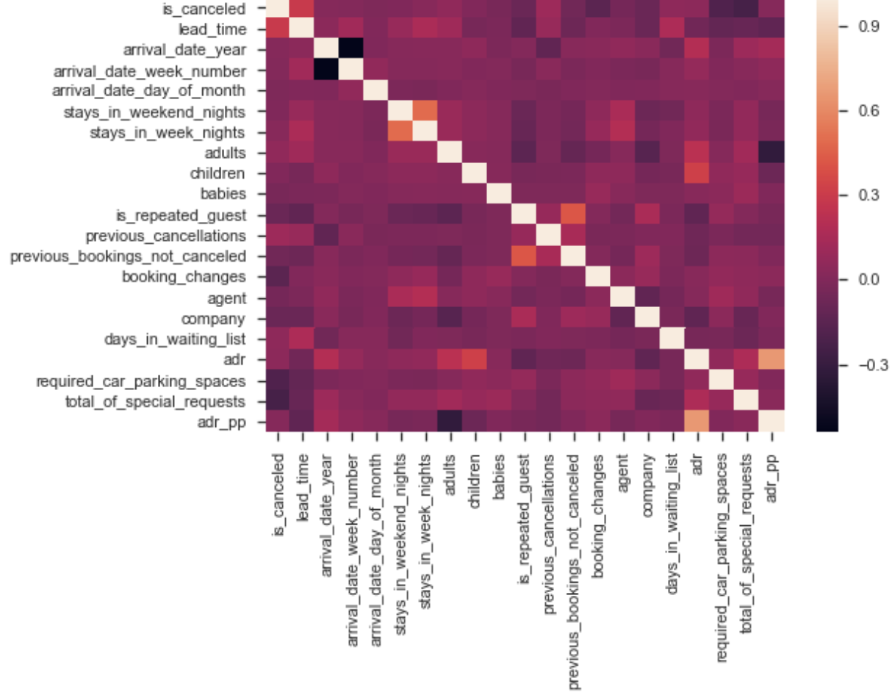
CORRELATION HEAT MAP

Slide 11
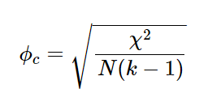
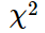
Feature Selection
Target Variable – is_canceled , type – categorical
The correlation coefficient is a measure of how two variables are related.
Cramér’s V Test to check association between two categorical variables.
Cramér’s V – Formula
Where-
- is the Pearson chi-square statistic component
- is the sample size involved in the test
- is the lesser number of categories of either variable

Slide 12
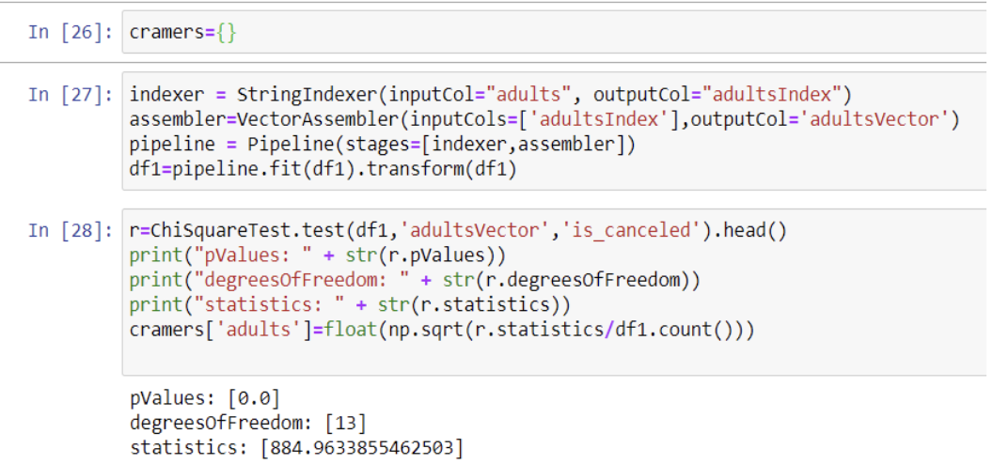
Feature Selection

Slide 13
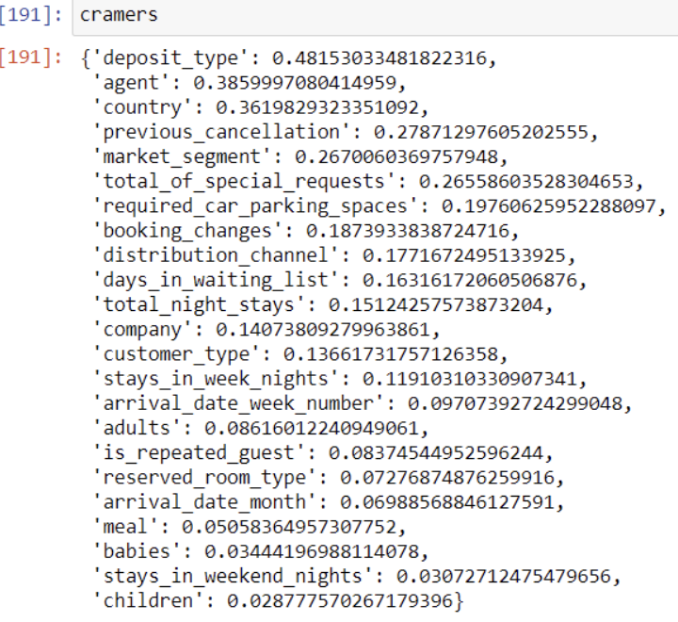
Relevant features according to Cramér’s V test.

Slide 14
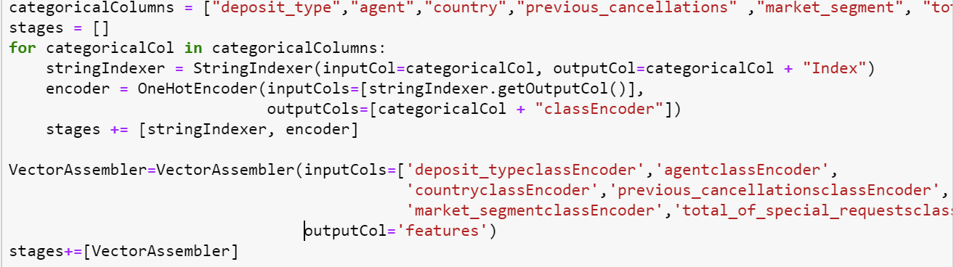
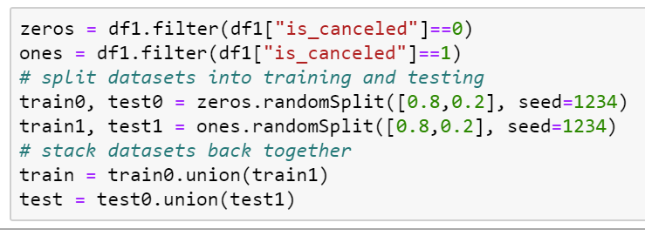
PREDICTIVE MODELING
Converted Categorical values to categorical indices using StringIndexer.
Mapped columns of category indices to a column of binary vectors, with at most a single one-value per row using OneHotEncoder.
Combined raw features and features generated by different feature transformers into a single feature vector using VectorAssembler.
Divided dataset into equal proportion of target variable to avoid biased predictions.

Slide 15
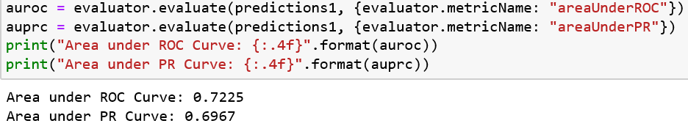
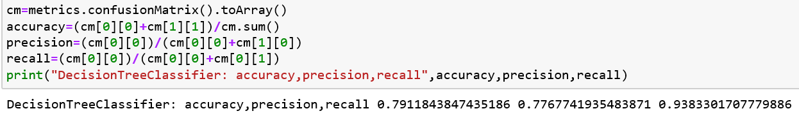
MODEL1- DECISION TREE

Slide 16
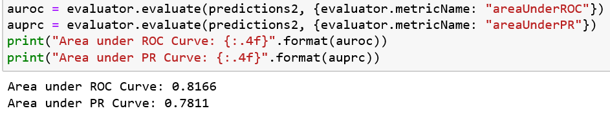
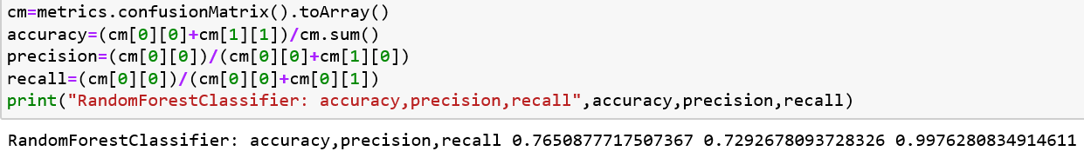
MODEL 2 - RANDOM FOREST

Slide 17
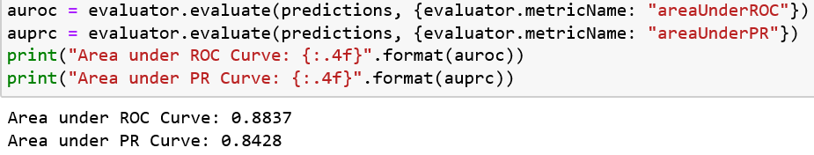
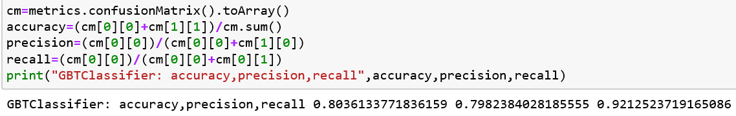
MODEL3- GRADIENT BOOST TREE

Slide 18
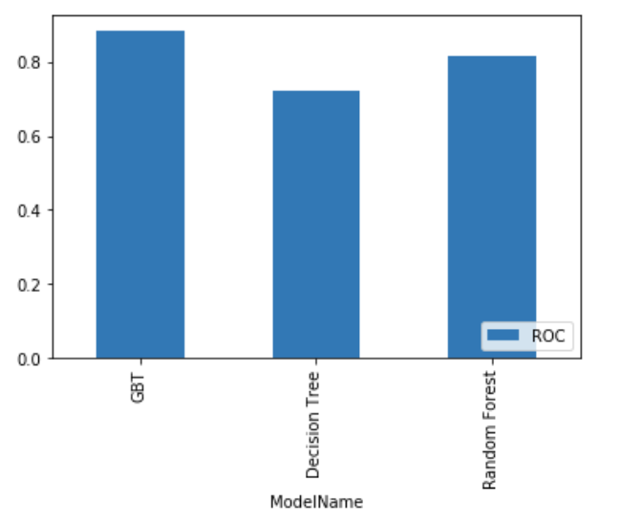
ROC CURVE READINGS

Slide 19

MODEL COMPARISION
Sr. No. | Model Name | Accuracy (approx.) | Precision (approx.) | Recall (approx.) | Area under ROC curve | Area under PR curve
1. | Decision Tree | 79.1% | 77.6% | 93.8% | 72.2% | 69.6%
2. | Random Forest | 76.5% | 72.9% | 99.7% | 81.6% | 78.1%
3. | GBT Classifier | 80.3% | 79.8% | 92.1% | 88.3% | 84.2%

Slide 20
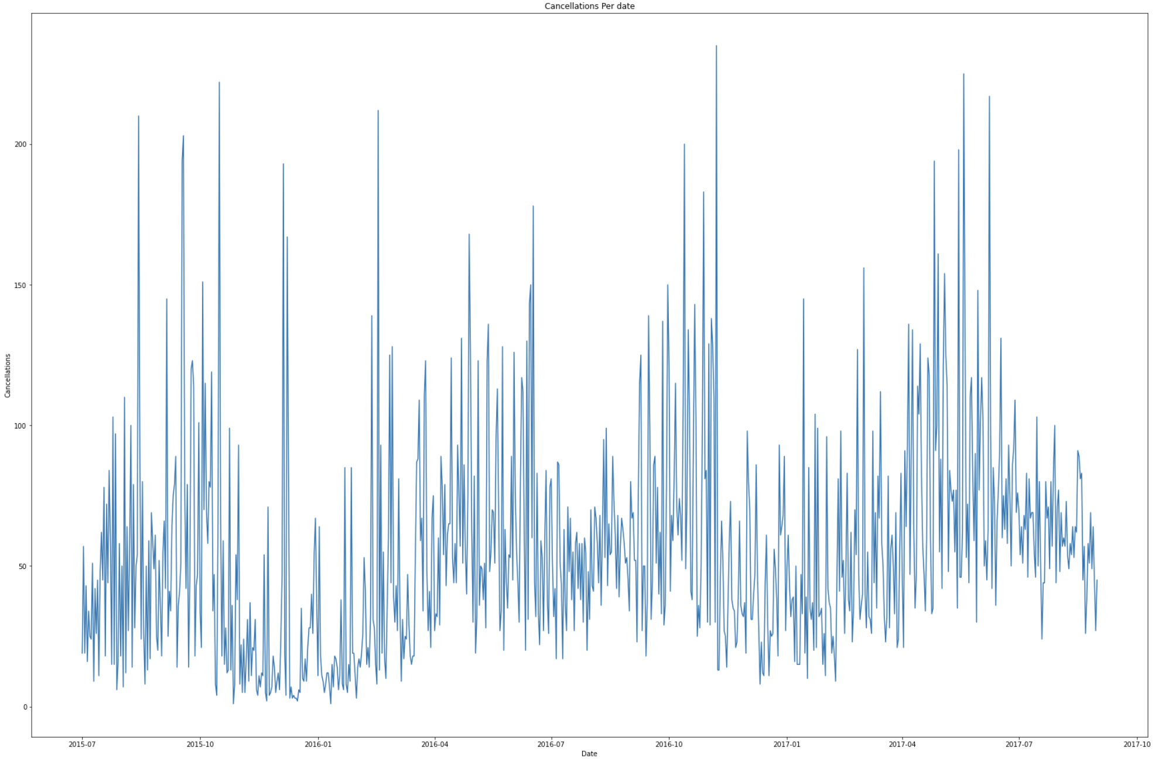
DEEP LEARNING – FORECASTING USING LSTM
Process
Merged the necessary column to create a DATE column
Aggregated the number of cancelations per day

Slide 21
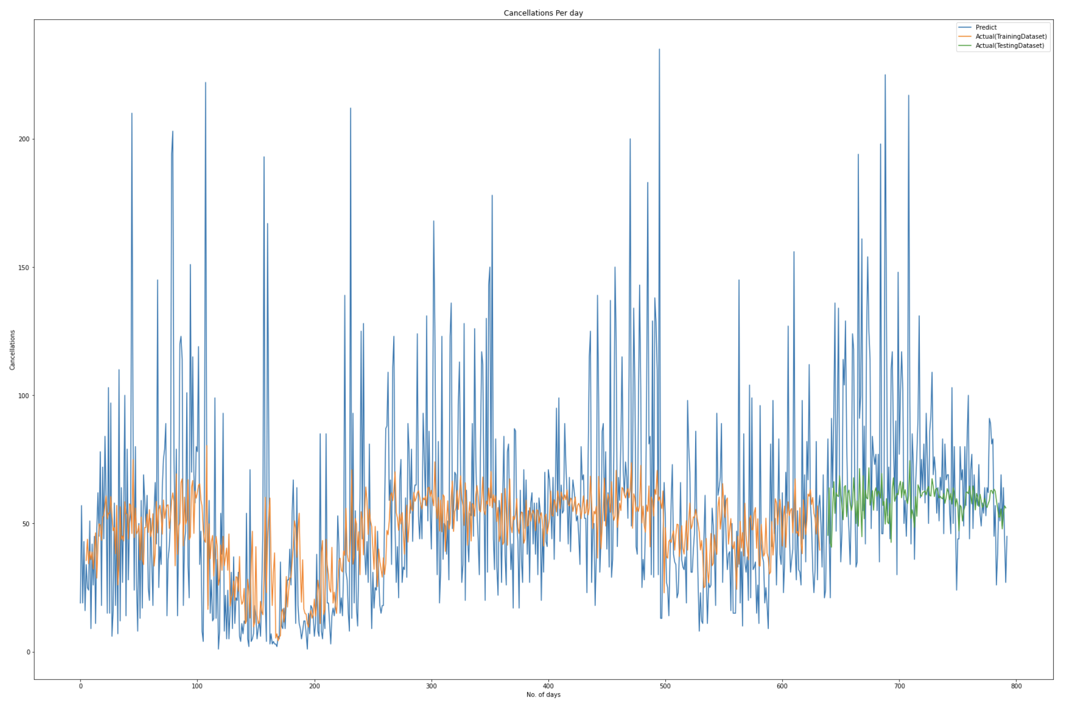
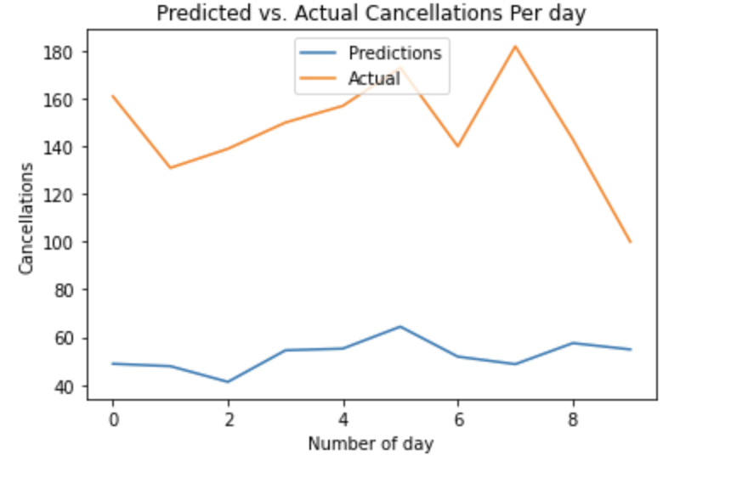
DEEP LEARNING – FORECASTING USING LSTM
Run the LSTM model after splitting the dataset into Testing and Training
Run the LSTM model on the Validation Data set

Slide 22
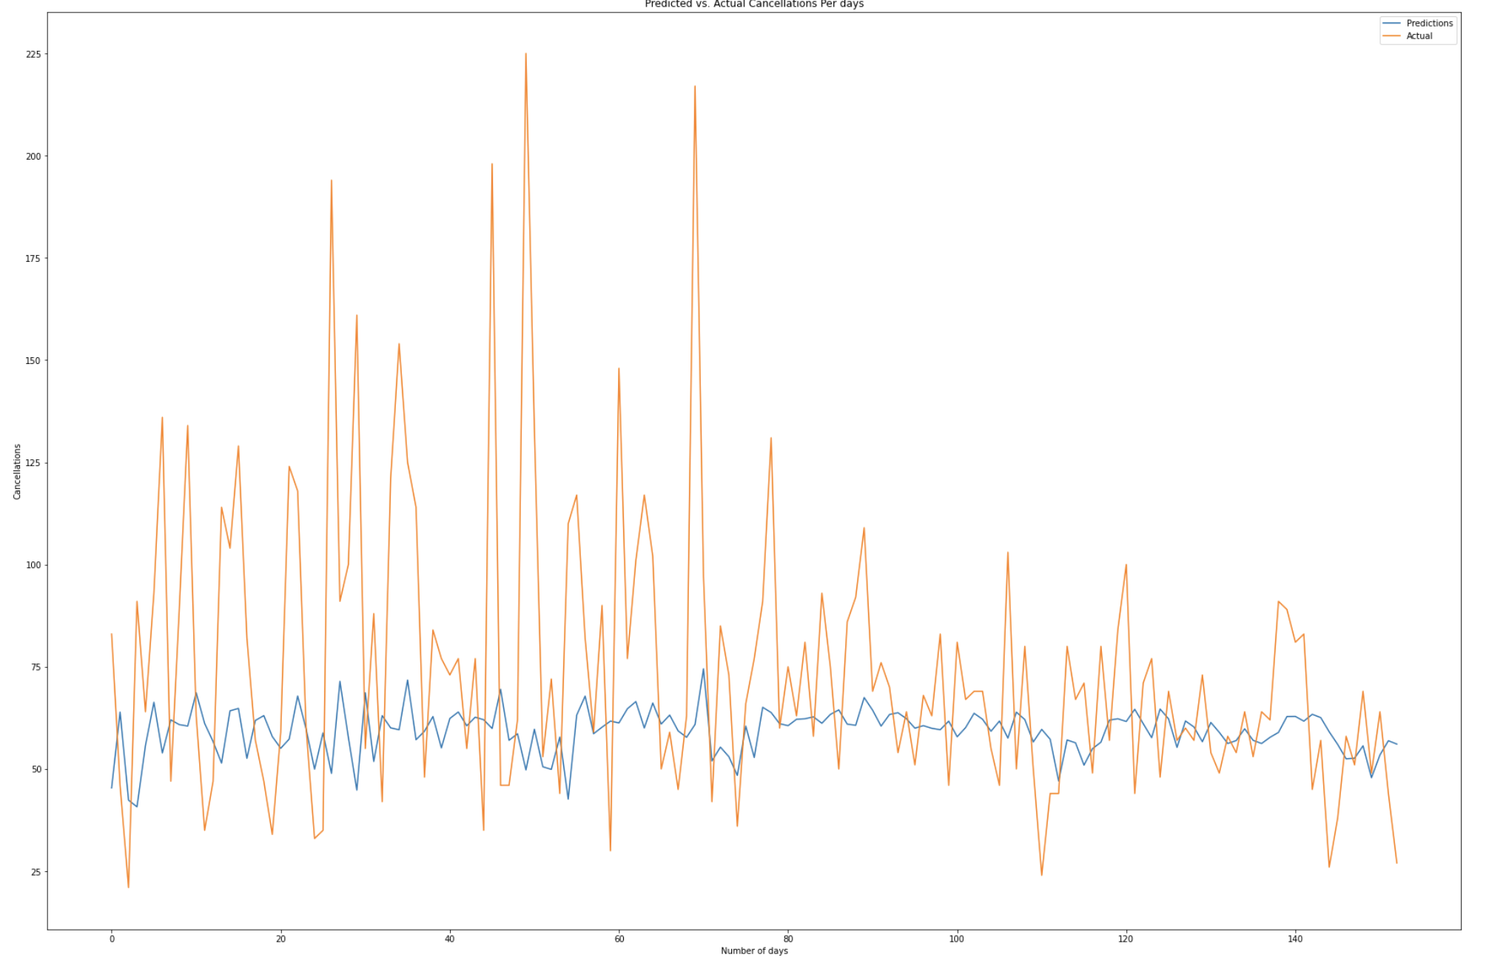
DEEP LEARNING – FORECASTING USING LSTM
As you can see the by taking days consideration for given duration the number of observations are high , hence we repeated the same set of process on the WEEKLY Date cancelation aggregation
Run the LSTM model after splitting the dataset into Testing and Training

Slide 23
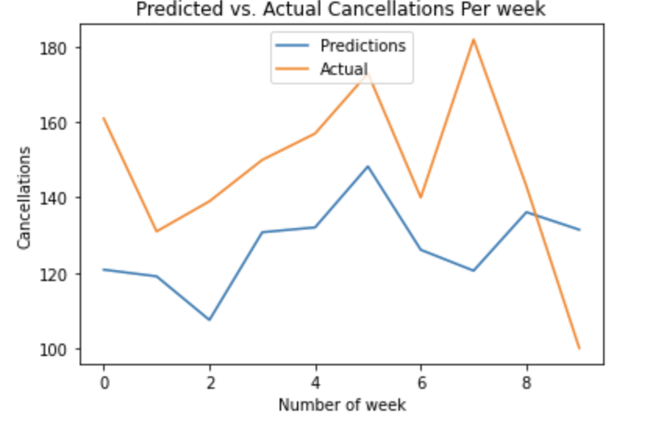
DEEP LEARNING – FORECASTING USING LSTM
Run the LSTM model on the Validation Data set

Slide 24

INSIGHTS AND RECOMMENDATIONS
Collect mandatory Deposits before a week of arrival to avoid short-term booking cancellations
Add more customization opportunities for the customers
Set Discounted or Advance Purchase Rates
Add Deals for Direct and Corporate Bookings
Send Reminder mails to the customers before arrival period and ask for their possible ETA
Use the "Flight booking Strategy "

Slide 25

ANY QUESTIONS ….?

Slide 26


